Slide 1

LLM as Judge (Concept)

Slide 2
LLM as Judge
LLM 1 generates output
LLM 2 evaluates quality
Improves quality control and regression testing

Slide 3
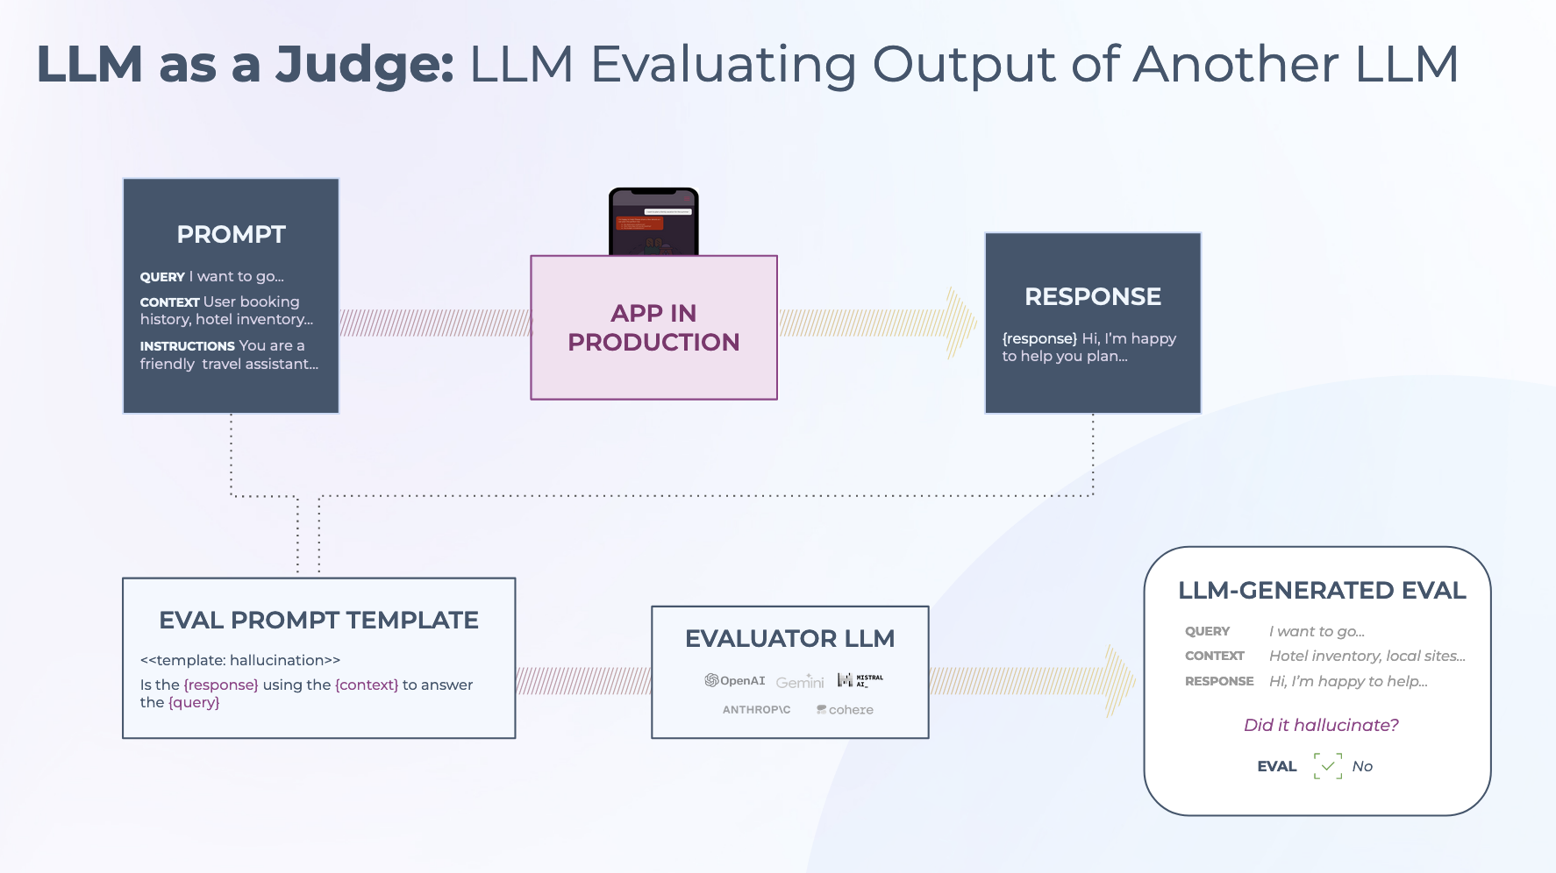
LLM as Judge

Slide 4
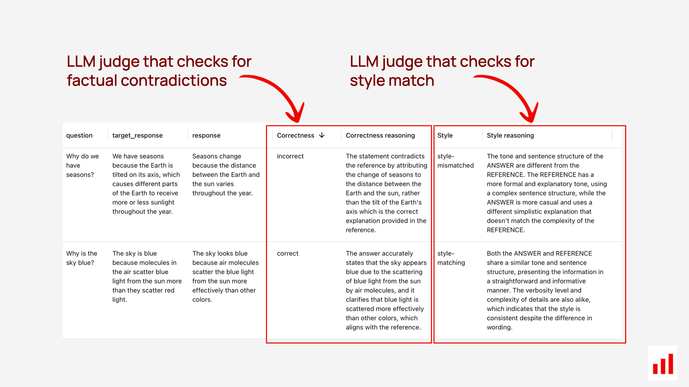
LLM as Judge

Slide 5
LLM as Judge Architecture
Generate Answer
Compare with context
Score: Faithfulness, Relevance, Completeness

Slide 6
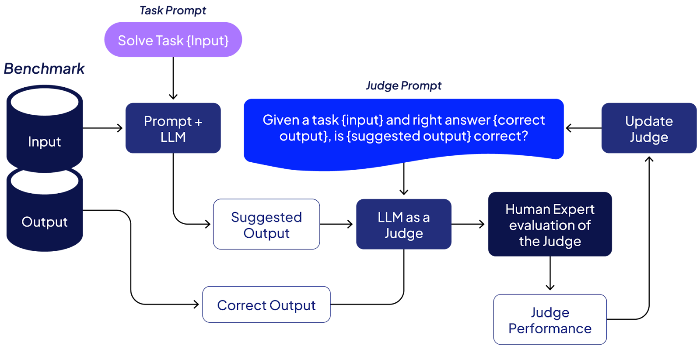
LLM as Judge Architecture

Slide 7
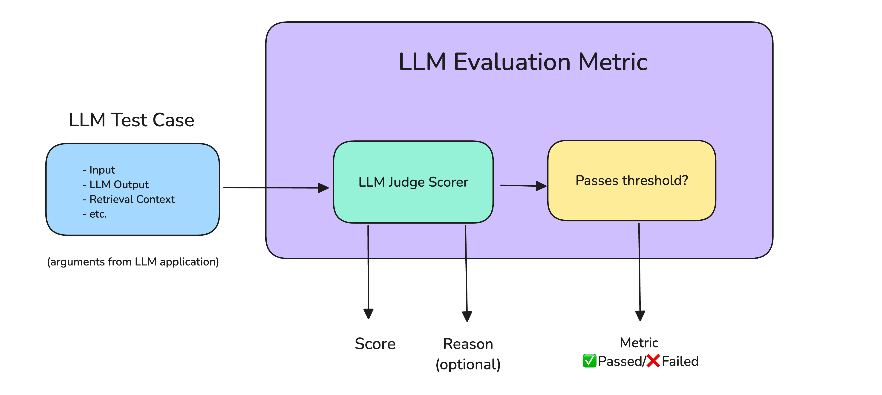
LLM as Judge Architecture

Slide 8
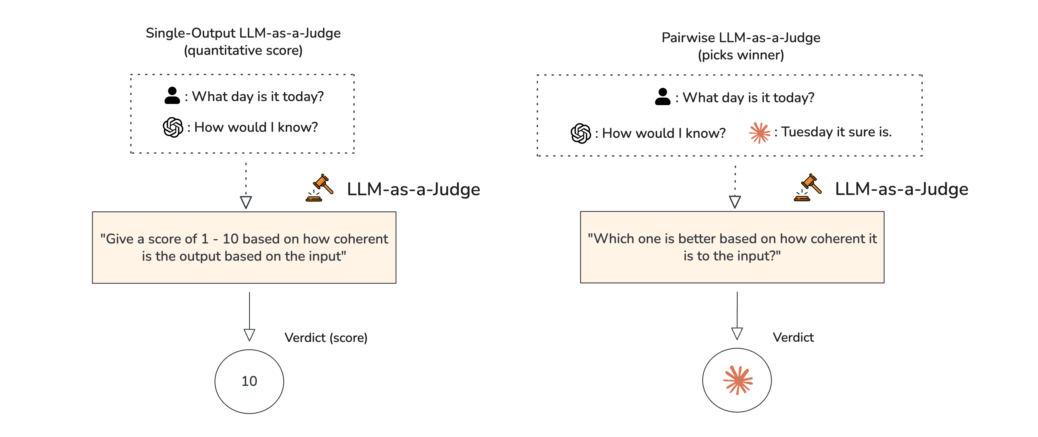
LLM as Judge Types

Slide 9
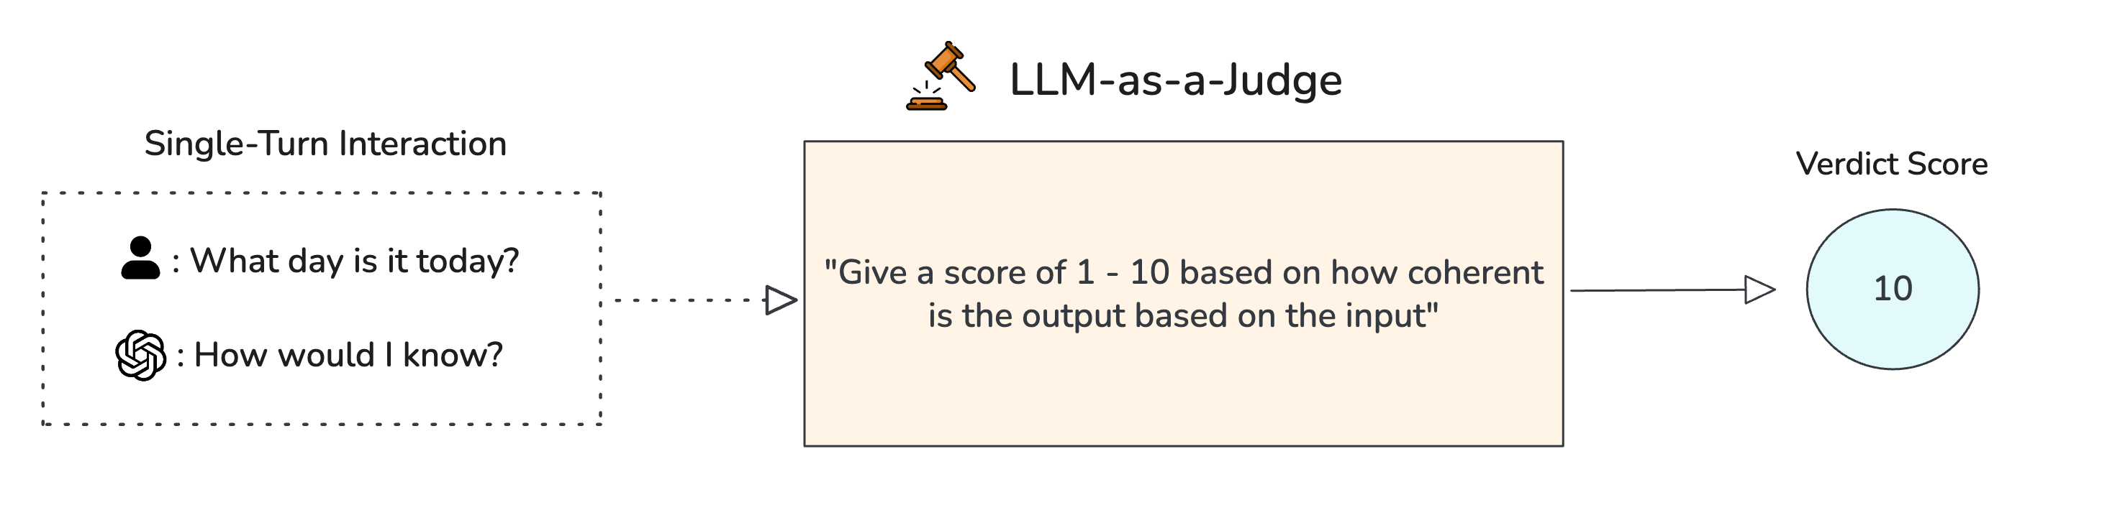
LLM-as-a-Judge Use Cases

Slide 10
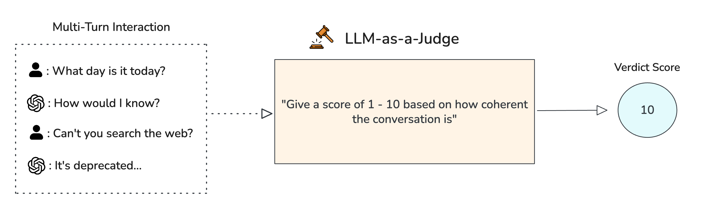
LLM-as-a-Judge Use Cases

Slide 11
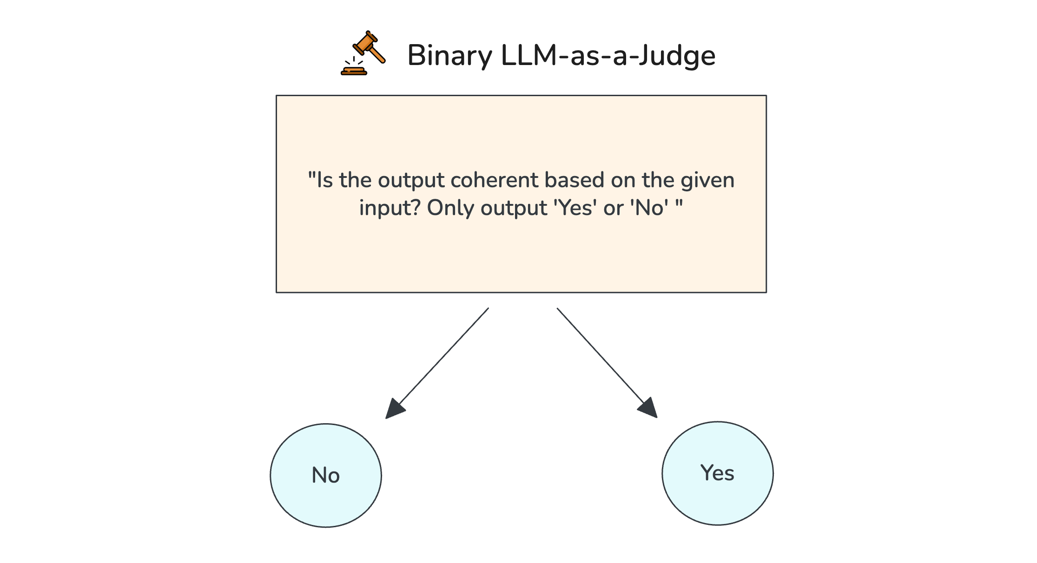
LLM-as-a-Judge Use Cases

Slide 12
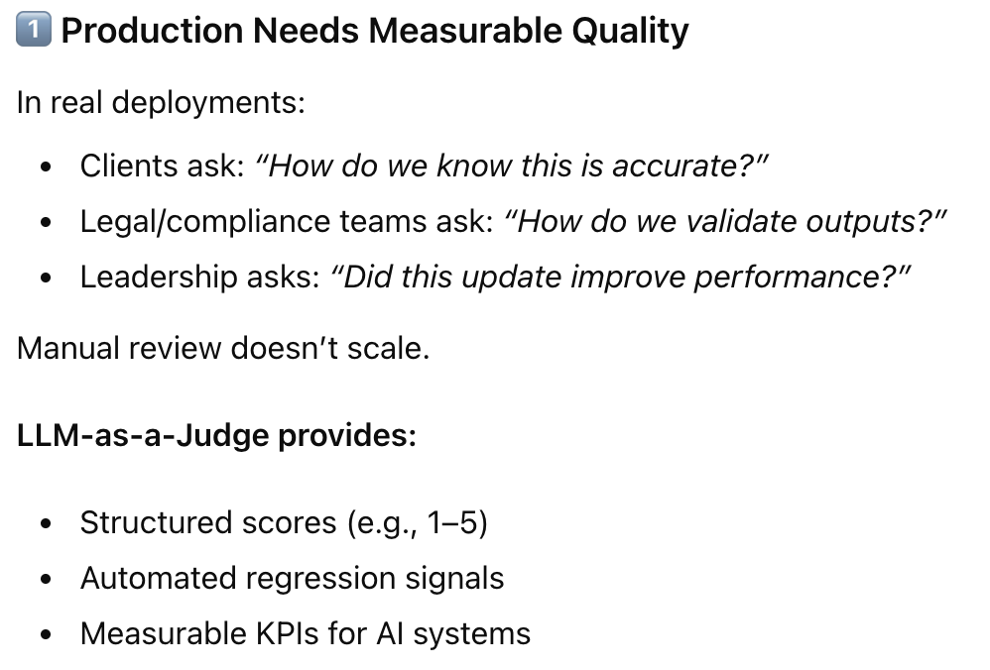
Why FDEs Use LLM as Judge

Slide 13
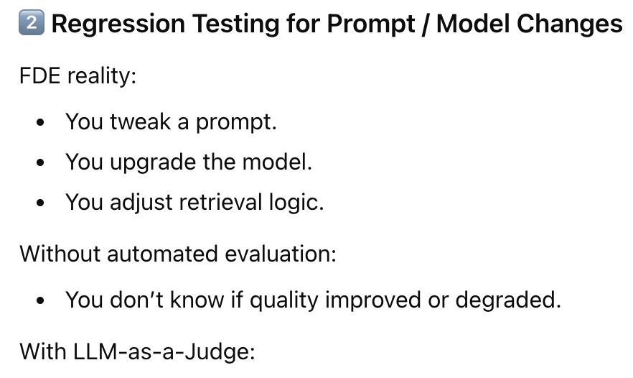
Why FDEs Use LLM as Judge
Old model score: 4.2
New model score: 3.6
→ Block deployment

Slide 14
References: LLM as Judge
OpenAI Evals
Anthropic Constitutional AI
LLM as a Judge research paper

Slide 15


Slide 16
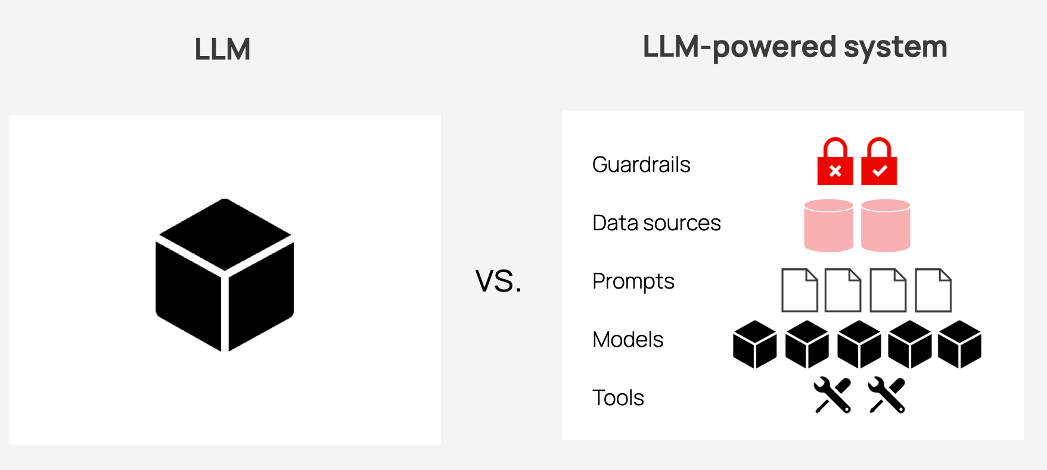
What is LLM evaluation?
LLM model evaluation
LLM system evaluation

Slide 17
LLM evaluation workflows
A software tool
A custom evaluation setup

Slide 18
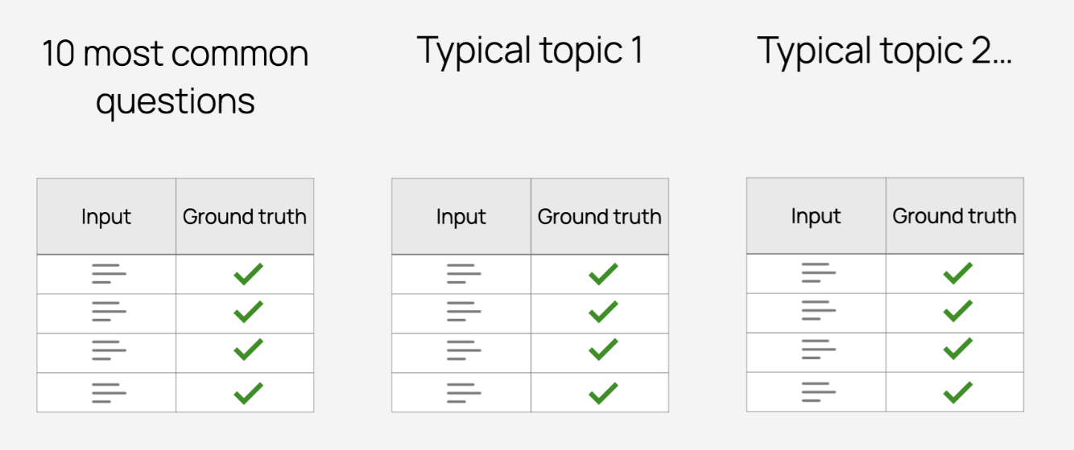
Evaluation datasets

Slide 19
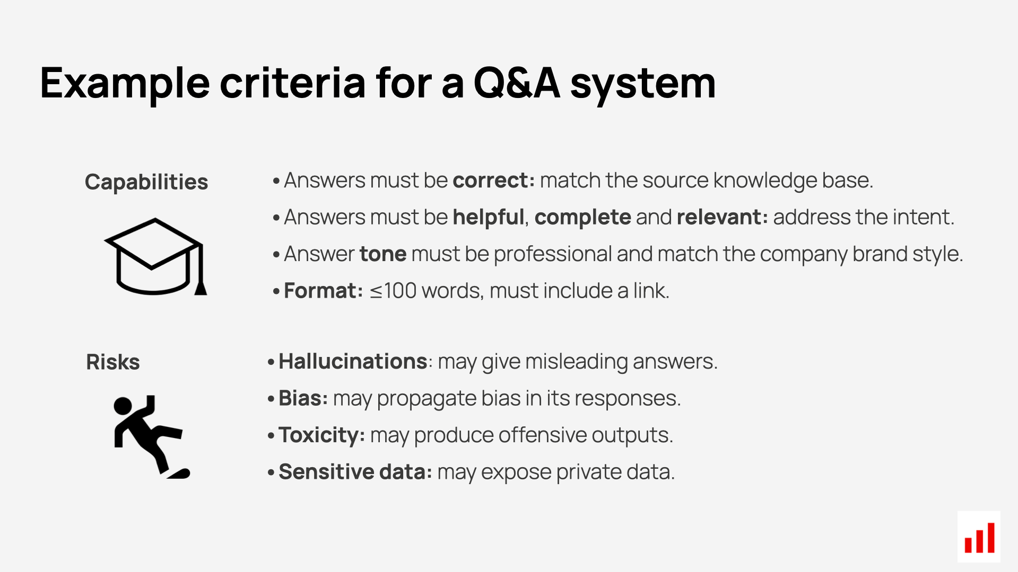
LLM evaluation workflows

Slide 20
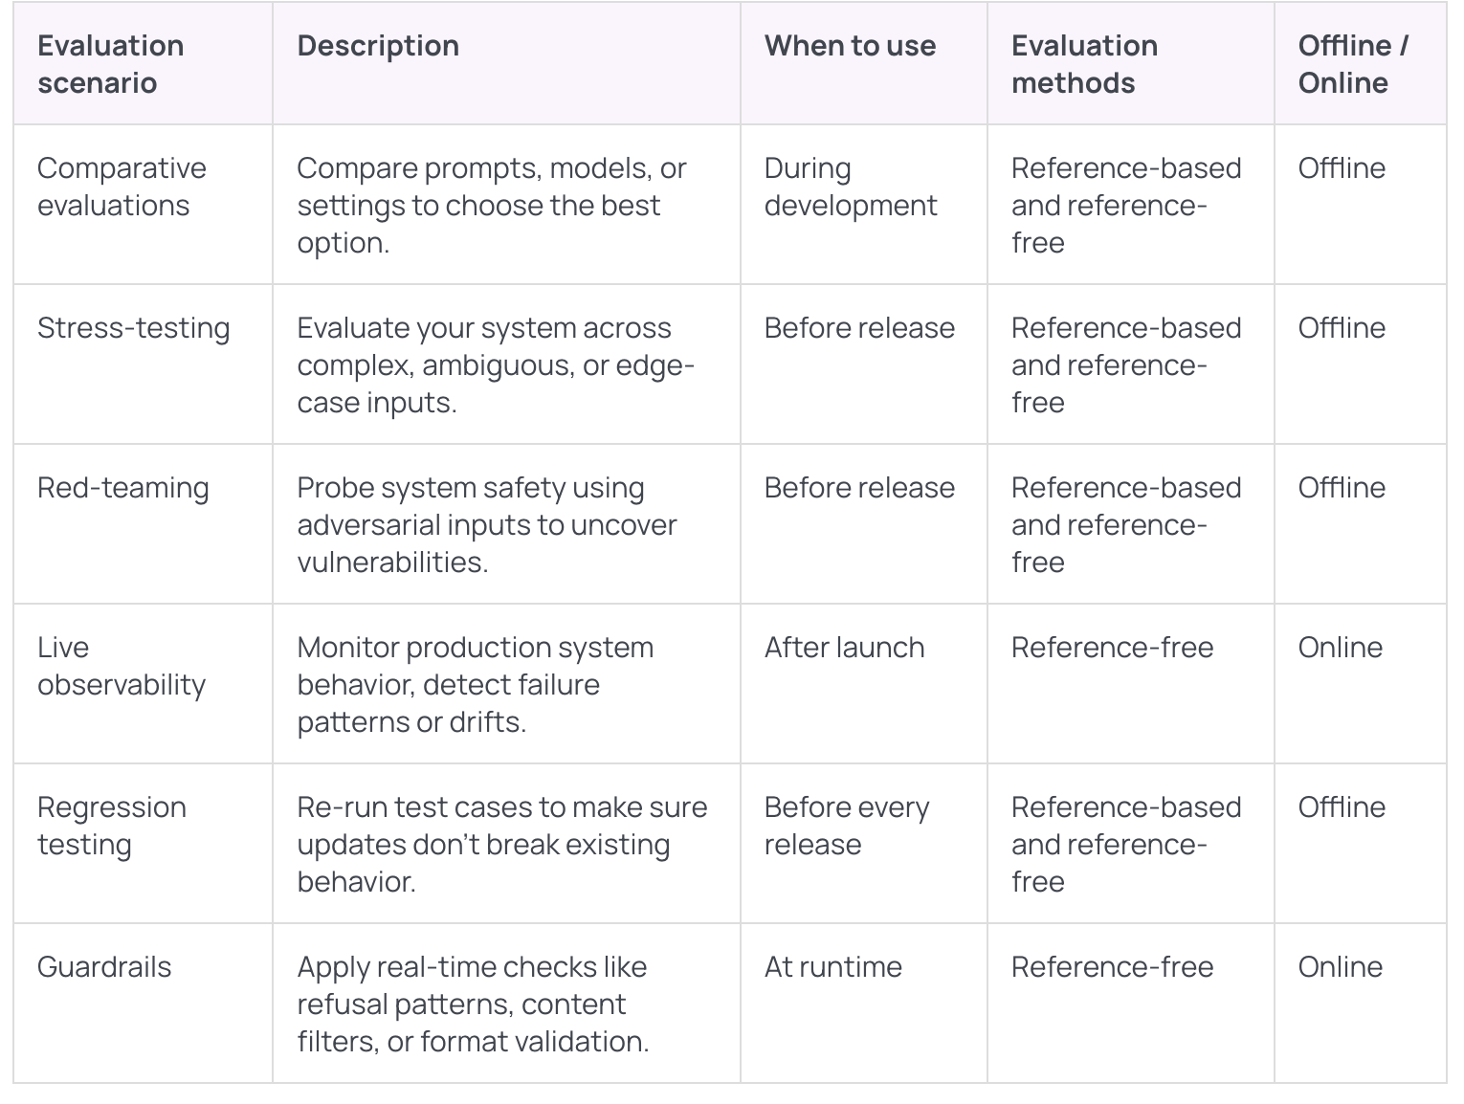

Slide 21

LLM Rankings

Slide 22


Slide 23
LLM Orchestration for Forward Deployed Engineers

Slide 24
Why FDEs Must Care About Orchestration
Problem: Single Prompt → LLM → Output
Fails in production due to hallucinations, no modularity, no control
FDE responsibility: Reliability, Quality, Cost control

Slide 25
Why Single-Prompt Systems Break
Enterprise queries are multi-step
No structure, no evaluation, no logging
Failure: Missed compliance, fabricated answers

Slide 26
Enter Orchestration
Structured control over multi-step reasoning
Tools, Memory, Retrieval, Evaluation
Pipeline → Controlled Steps → Guardrails

Slide 27
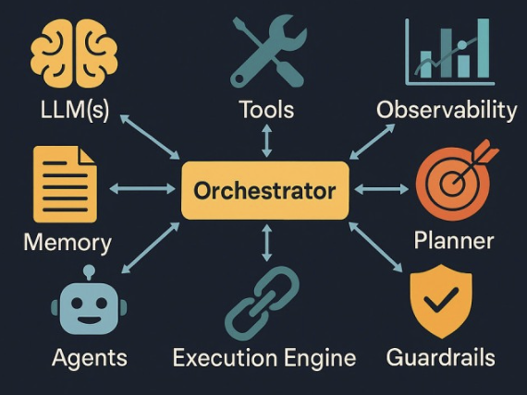
What Is Orchestration?
Structured control over:
Multi-step reasoning
Tool calls
Memory
Retrieval
Evaluation

Slide 28
Why We Need Orchestration Frameworks
Avoid spaghetti code
No hardcoded prompts
Add memory, tools, audit logs

Slide 29
What Orchestration Frameworks Solve
Chain abstraction
Prompt templating
Tool management
Retrievers & tracing

Slide 30
LLM Pipelines & Chaining Concepts
Break complex problems into steps
Step 1 → Step 2 → Step 3 → Final Output

Slide 31
Enterprise Data Q&A Example
Retrieve financial docs
Extract numbers
Analyze trends
Generate explanation
Validate with judge

Slide 32
Types of Chains
Sequential
Conditional
Router
Parallel
Agent-based

Slide 33
Sequential Chain Diagram
Step 1 → Step 2 → Step 3
Error propagation risk
Latency considerations

Slide 34
When Chaining Breaks
Latency explosion
Token cost increases
Need logging & retries

Slide 35
Introducing LangChain
Framework for LLM orchestration
Supports RAG, Agents, Tools

Slide 36
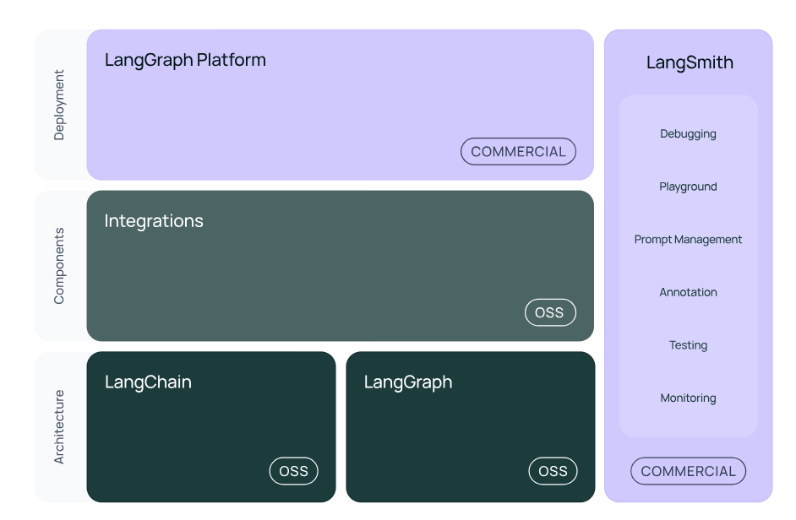

Slide 38
LangChain Architecture Overview
Prompts
Chains
Memory
Tools
Retrievers

Slide 39
Prompts in LangChain
Prompt templates
Parameterization
Version control

Slide 40
Chains in LangChain
Prompt + Model + Parser
Composable & structured output

Slide 41
Memory in LangChain
Conversation Buffer
Summary Memory
VectorStore Memory
Token cost management

Slide 42
Tools in LangChain
DB queries
API calls
Python execution
Search integration

Slide 43
Retriever Concept
Abstraction over vector DB
get_relevant_documents()

Slide 44
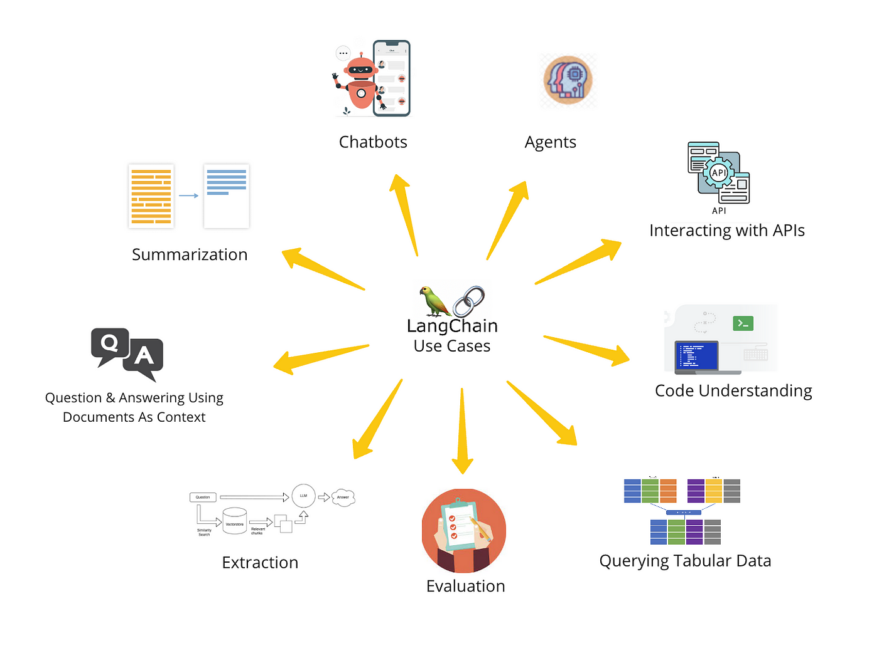
LangChain UseCases

Slide 45
Integration with Vector Databases
Store embeddings
ANN search
Metadata filtering
Hybrid search

Slide 46
Popular Vector Databases
Pinecone
Weaviate
Milvus
Qdrant
FAISS

Slide 47
Why Retrieval Is Not Optional
Reduces hallucinations
Provides grounding
Production baseline

Slide 48
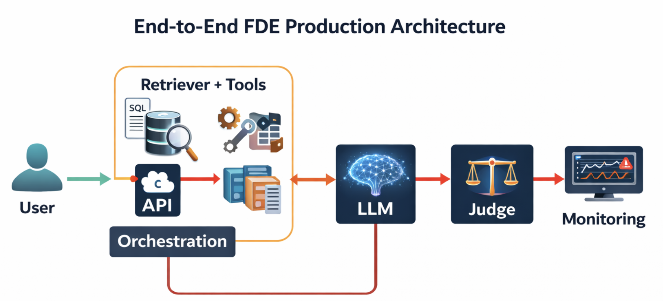

Slide 49
Observability (Critical for FDE)
Track prompts
Latency
Token usage
Judge scores

Slide 50
Failure Modes in Production
Tool misuse
Recursive loops
Latency spikes

Slide 51
Cost Considerations
Each chain adds cost
Balance reliability vs expense

Slide 52
When NOT to Use LangChain
Simple single call
No tools or retrieval
Low complexity apps

Slide 53
Advanced Orchestration: Agents
Dynamic tool usage
Flexibility vs Control tradeoff

Slide 54
LLM as Judge Production Loop
Generate → Judge → Retry → Return

Slide 55
Real FDE Deployment Example
Enterprise HR chatbot
Added RAG + Judge + Logging
Reduced hallucinations

Slide 56
Articles for Reference
LangChain Docs
Vector DB comparison
RAG paper
OpenAI Evals

Slide 57
Deployment Checklist for FDE
Retrieval tested?
Judge integrated?
Latency within SLA?
Monitoring enabled?

Slide 58
Key Takeaways
Single prompts fail in production
Orchestration is mandatory at scale
LLM as judge improves reliability
Retrieval is non-negotiable

Slide 59
Appendix – Advanced Topics
Hybrid search
Cross-encoder reranking
Structured outputs
Agent vs Chain tradeoffs

